Slide 1

Online Lab Tests Booking

Slide 2
Team Members:
Sreepranav (Team Lead, Front End Developer and Back End Developer)
Vamshi Krishna Reddy(Designer)
Harini (Front End Developer)
Sruthi (Web Designer)

Slide 3
Introduction:
Indus Health is a web-based application developed using Java programming language. It mainly focuses on placing lab tests easily using internet. Admin and customers all will have different interface and different privileges according to their needs.A customer can only manage his account and cannot see any details of other customers. Admin can see the details of all customer accounts. Admin can process the orders placed by the customers.

Slide 4
Objective:
To develop an online website to place medical tests.
Provide easy way to do the lab tests at home
Functionalities provided:
Place required medical tests.
View the status of test.

Slide 5
Modules:
There will be two main interfaces for our website. One is for admin and the other is for the user, here user is a customer.
1.Registration Page
2.Login Page
3.Main Page
4.Place an order
5.View Orders
6.Admin Page
7.Update Order Page

Slide 6
Technologies Used:
Front End:
1.HTML
2.CSS
3.JavaScript
Back End:
1.Java(Programming Language)
2.Apache Tomcat(Server)
3.Hibernate(API/ORM)
4.Oracle(Database)

Slide 7
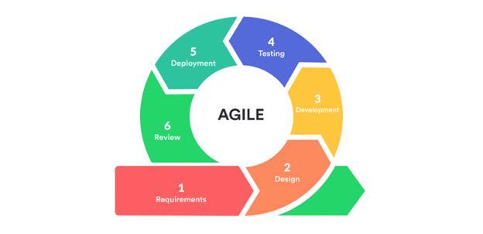
Agile: Phases of Extreme Programming:

Slide 8
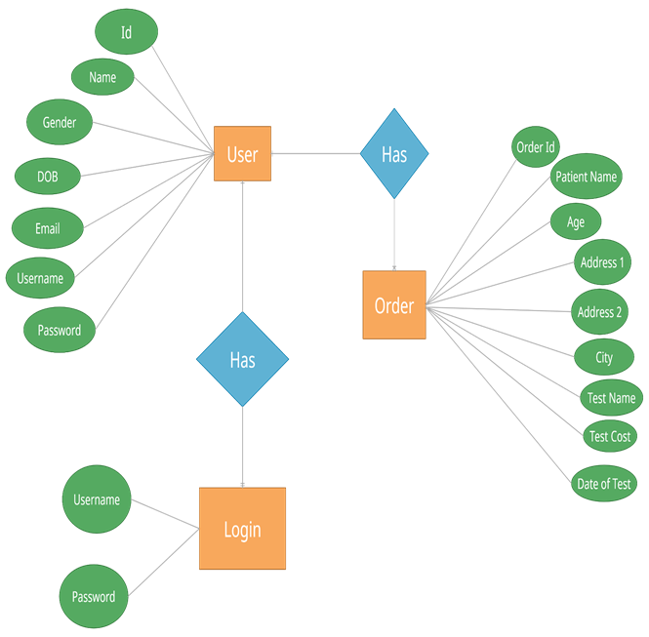
ER Diagram

Slide 9
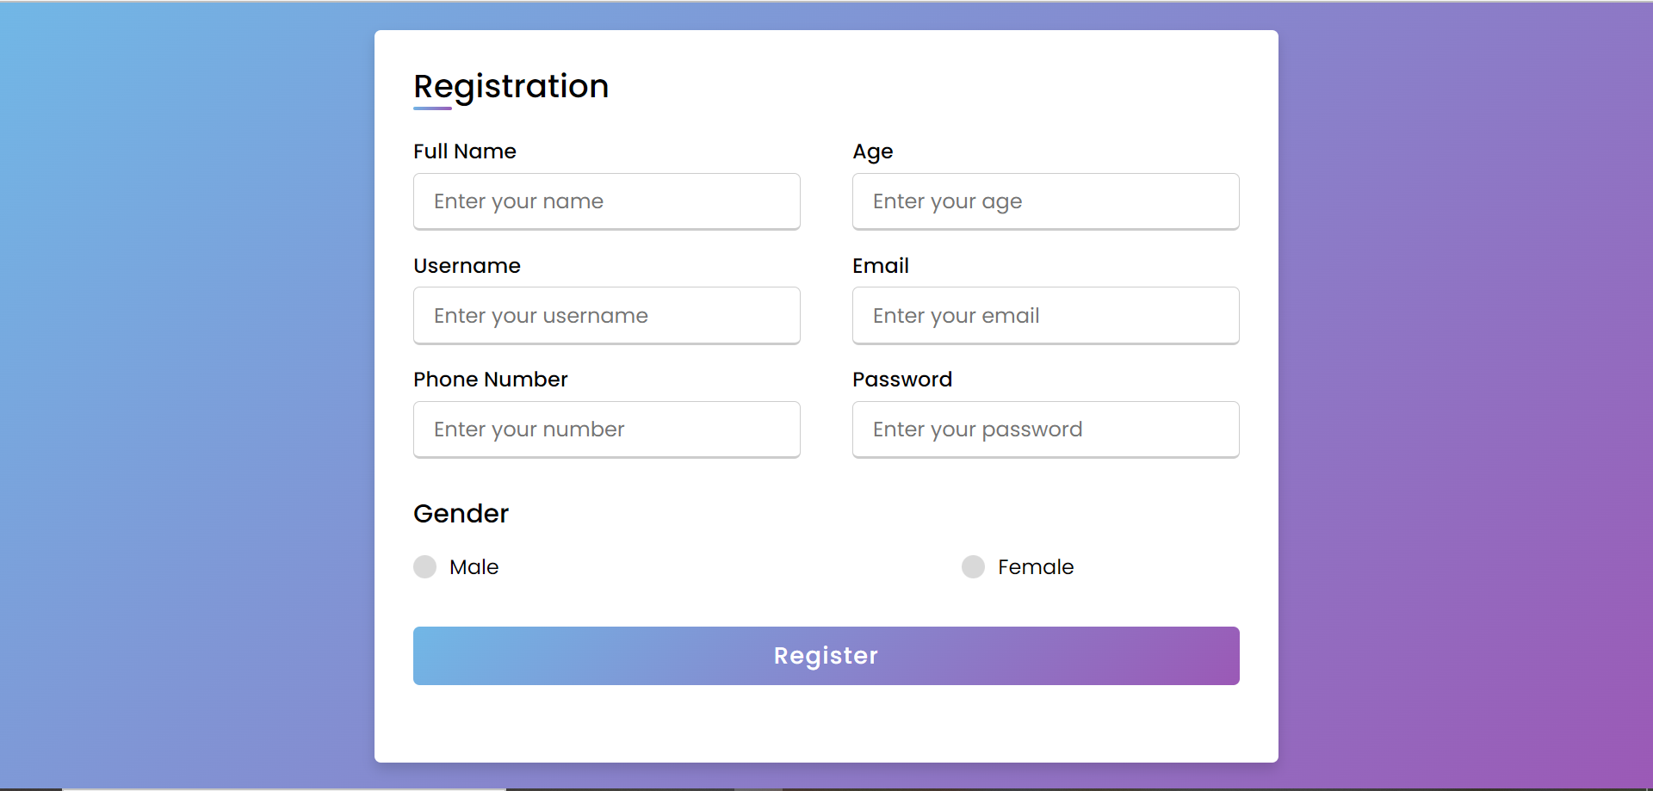
Registration Page

Slide 10
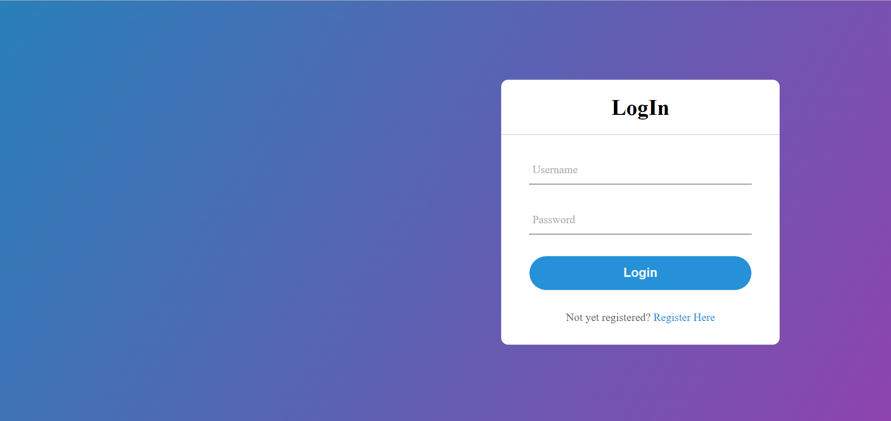
Login Page

Slide 11

User Home Page

Slide 12
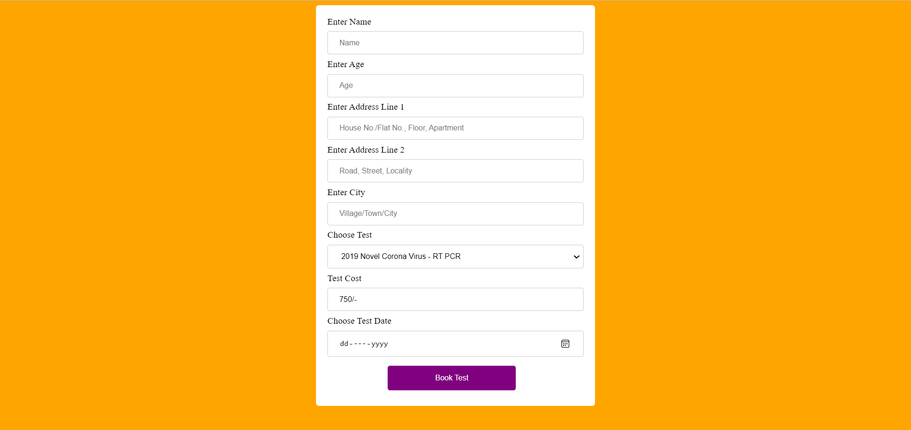
Test Booking Page

Slide 13
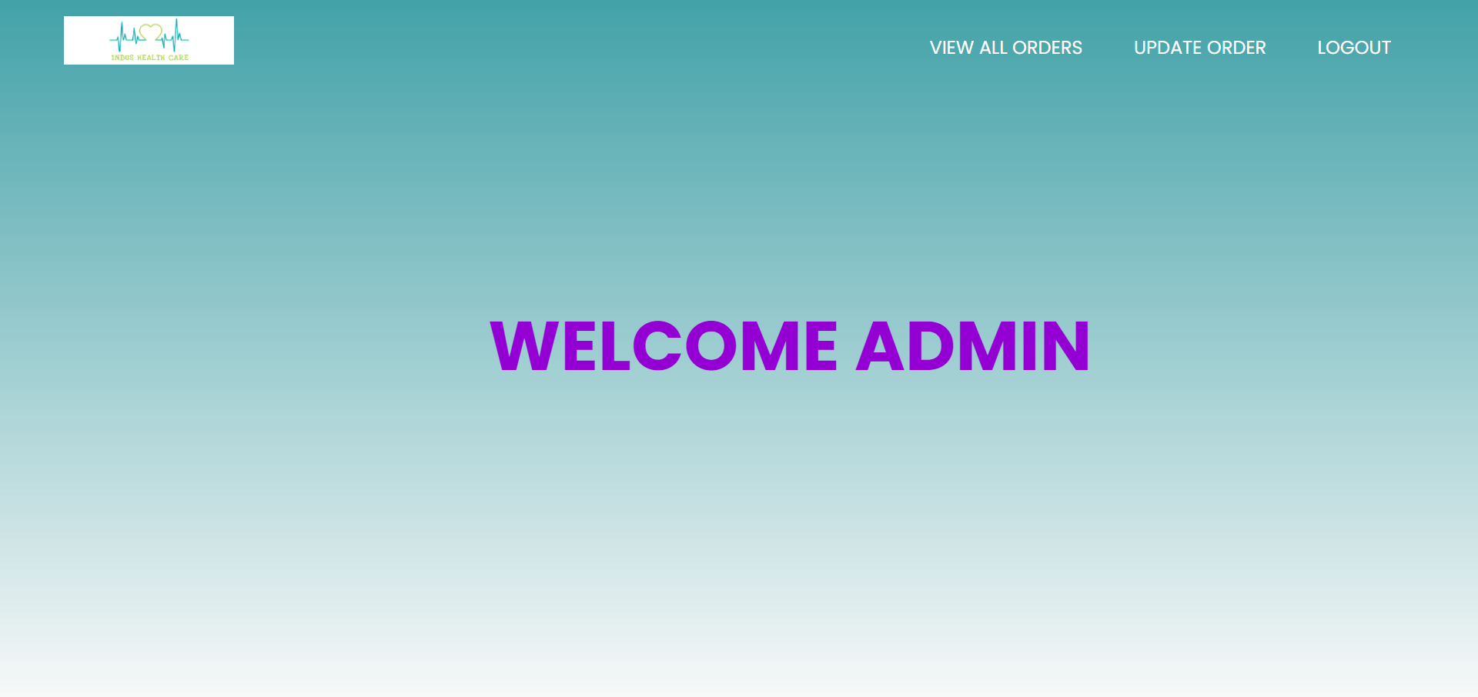
Admin Home Page

Slide 14
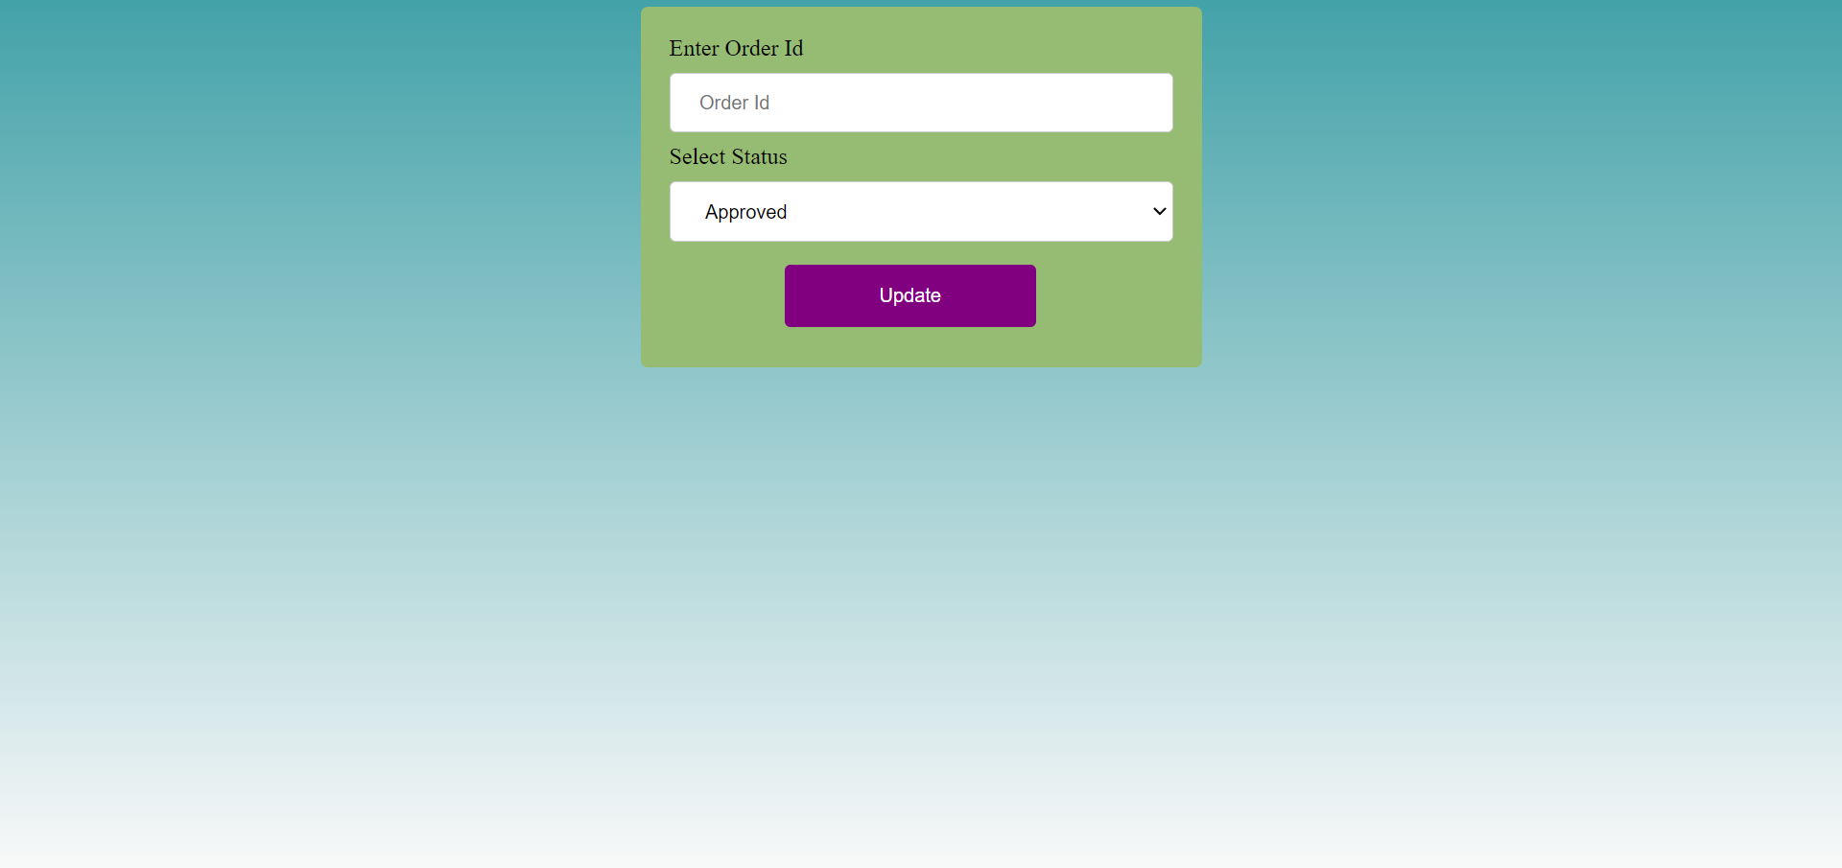
Order Update Page

